Slide 1
MAE 200 Fall 2019 Intro to Mechanical Engineering Design
Design Project
DUE: due last day of class (hard copy to TA)
Team: B Section: 001
Team Members
#1- Ashley Crickard
#2- Devin Claridge
#3- Luis Felipe Caicedo
#4- Ralph Denhartog
#5- Ethan Cole

Slide 2
Outline
Brainstorming Boat Designs
Fabrication Process
Testing Process
Calculation of Payload Weight

Slide 3
Brainstorming Boat Designs
20.0 in
30.0 in
We understood that it was important to get the maximum displacement of water.
We also wanted to make sure we had enough surface area for the boat to float.

Slide 4
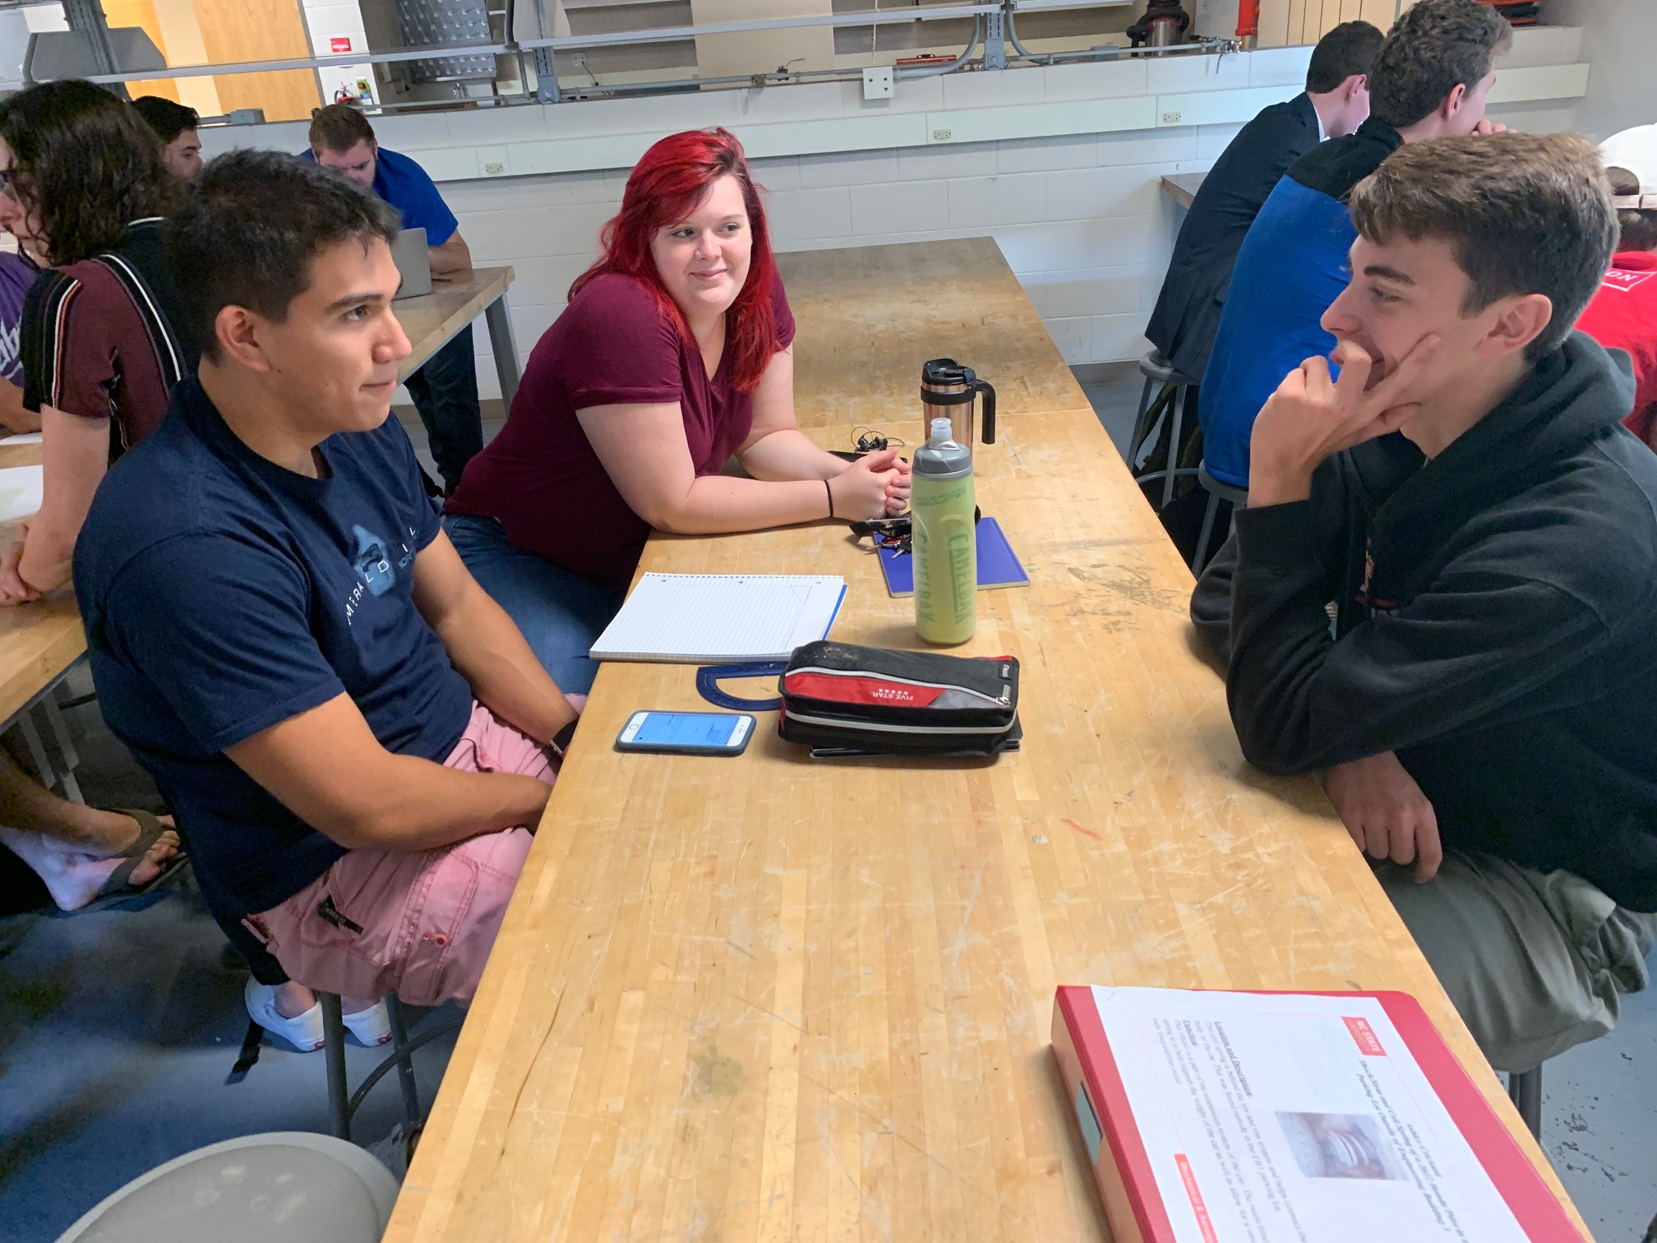
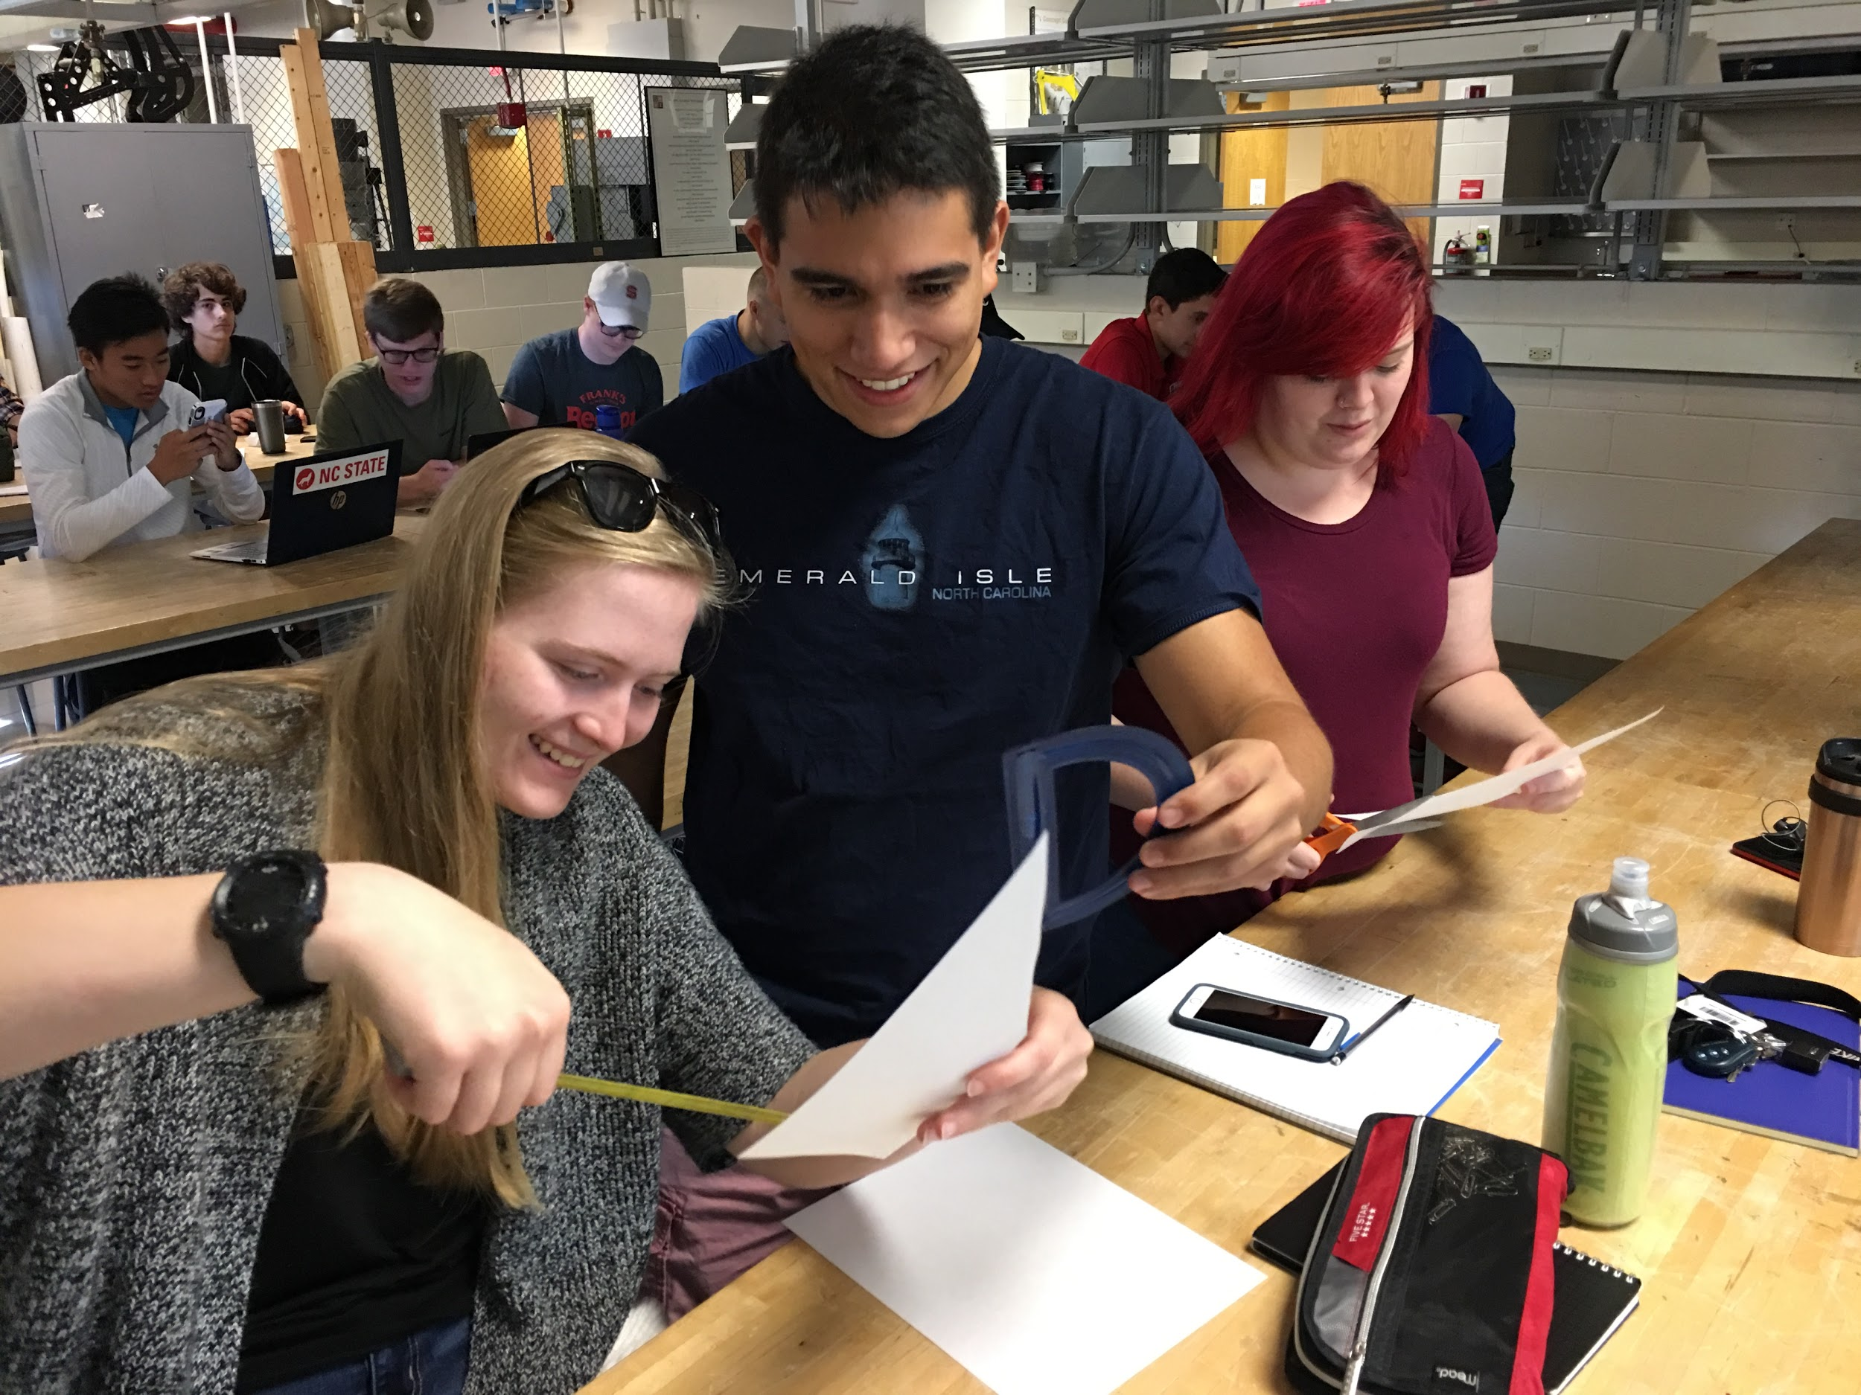
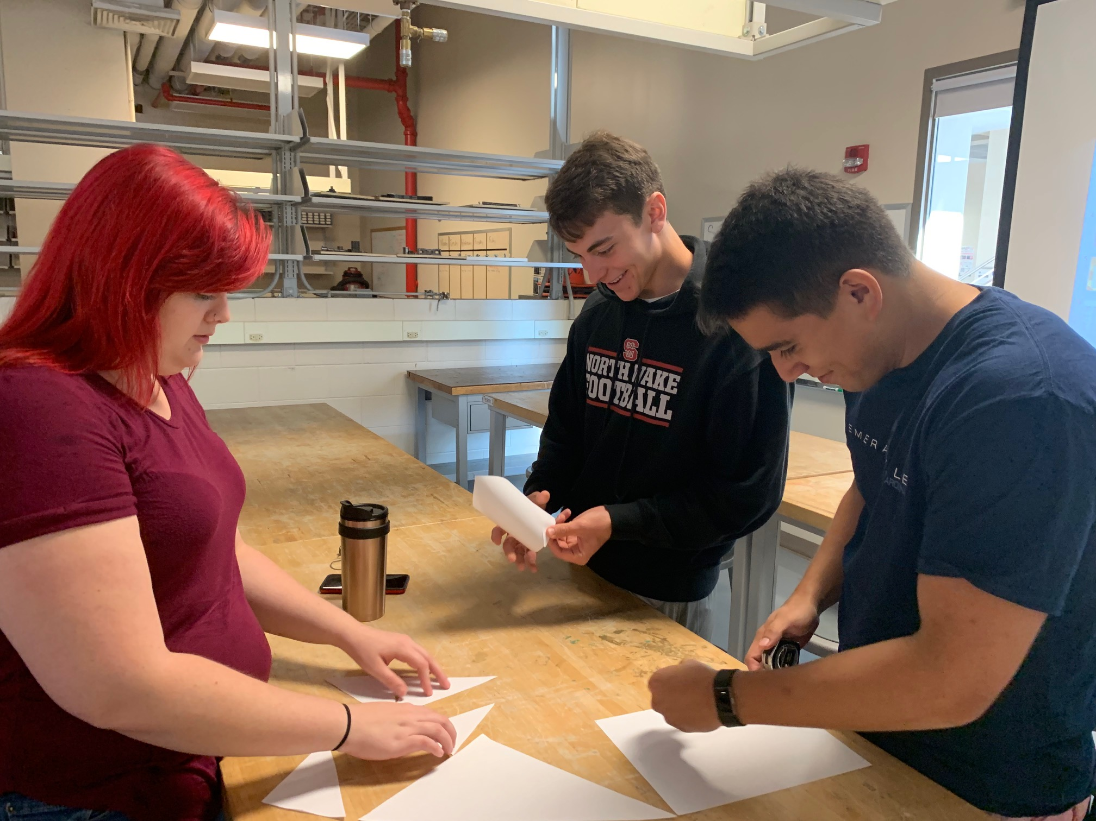
Brainstorming Boat Designs
First we discussed our course of action and strategy for the boat’s design (pictured left).
We decided to maximize the volume of water displaced in order to maximize the amount of water displaced.
To get the maximum water displaced, proper utilization of the surface area also needed to be taken into account.
Next we began developing potential designs with proportional-sized pieces of paper.

Slide 5
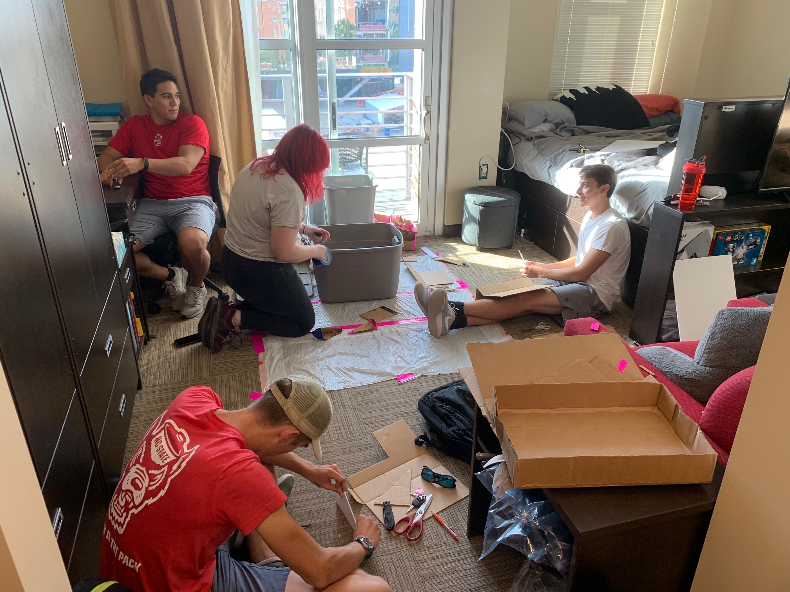
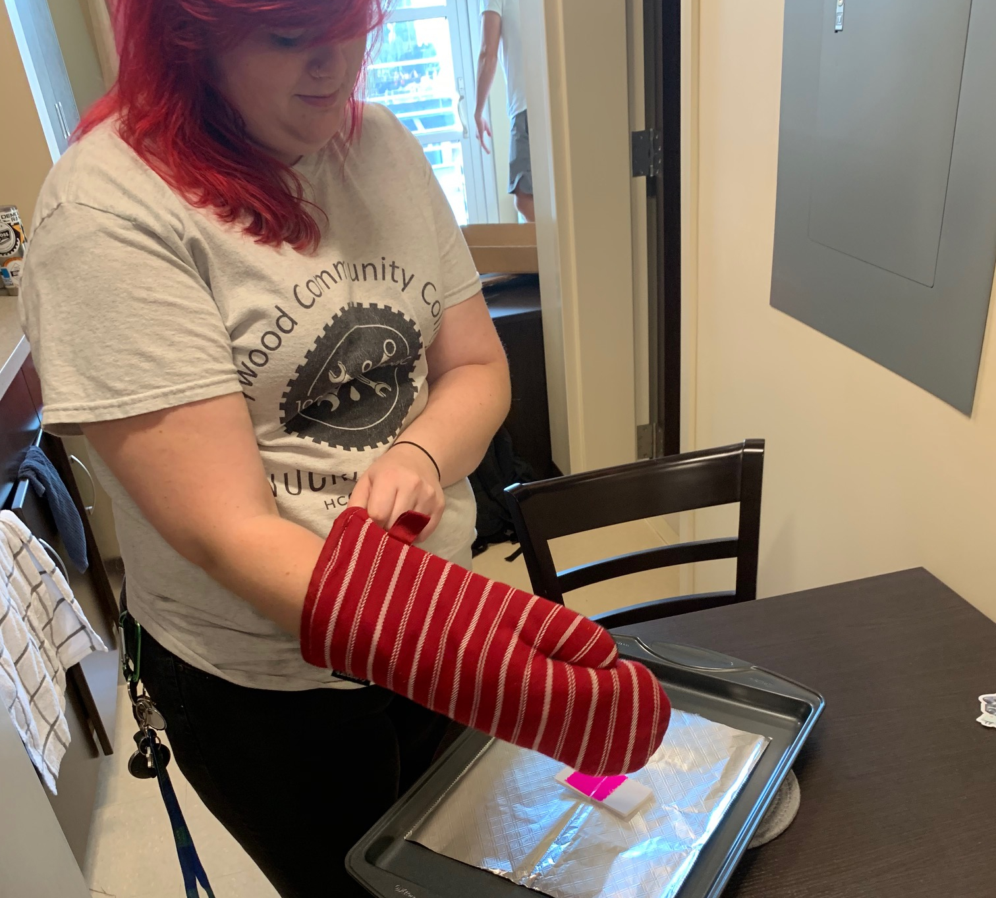
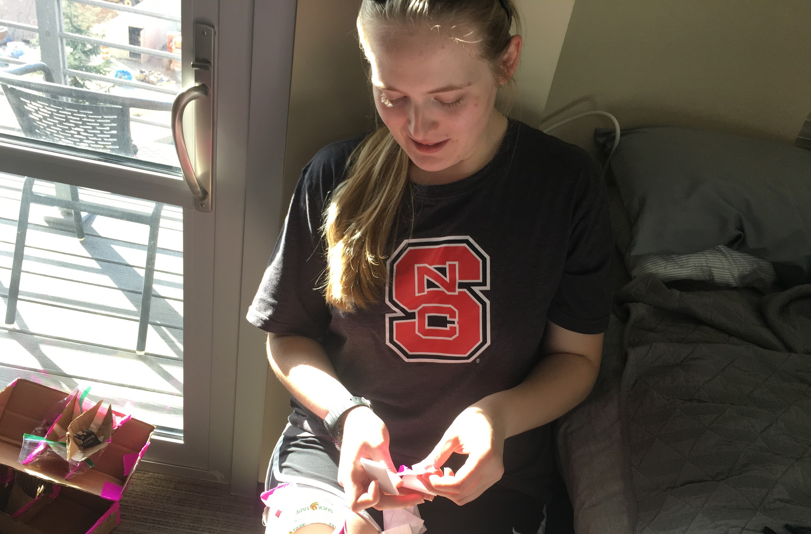
Preliminary Fabrication Process
All team members were given the same amount of material to create their own ideas for the best design.
This allowed us to delineate which design was most efficient and also determine who was the best “cutter” and “taper.”

Slide 6
Fabrication Process
20.0 in
20.0 in
30.0 in
15.0 in
15.0 in
3.50 in

Slide 7
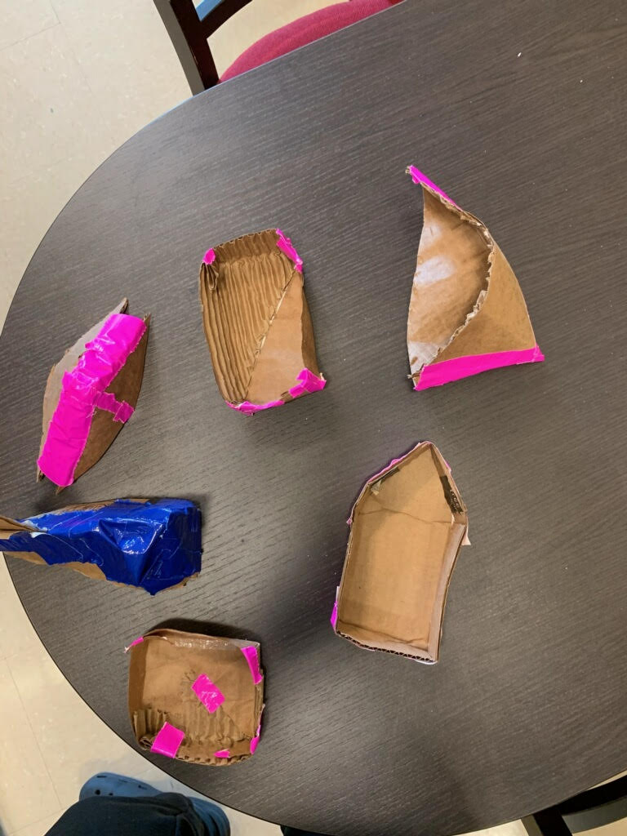
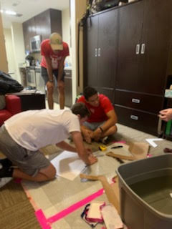
Testing Process
Many iterations of boat designs were tested and considered. We even tried baking the foam board to see if this would decrease water absorption and increase buoyancy.

Slide 8
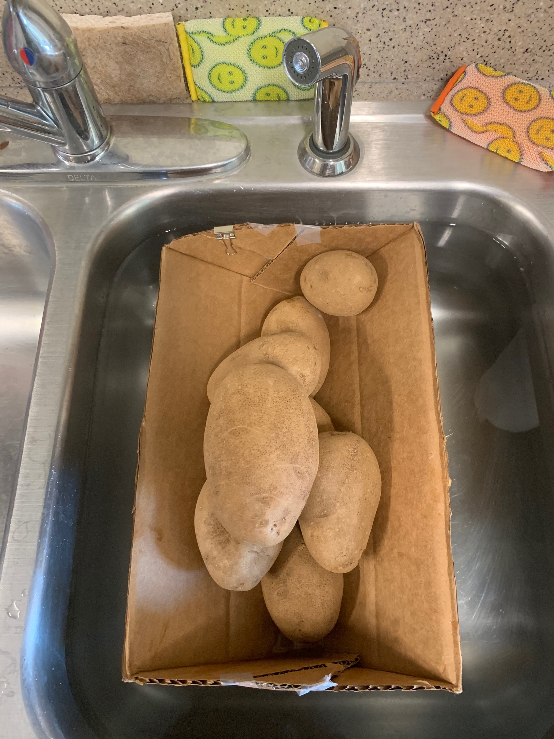
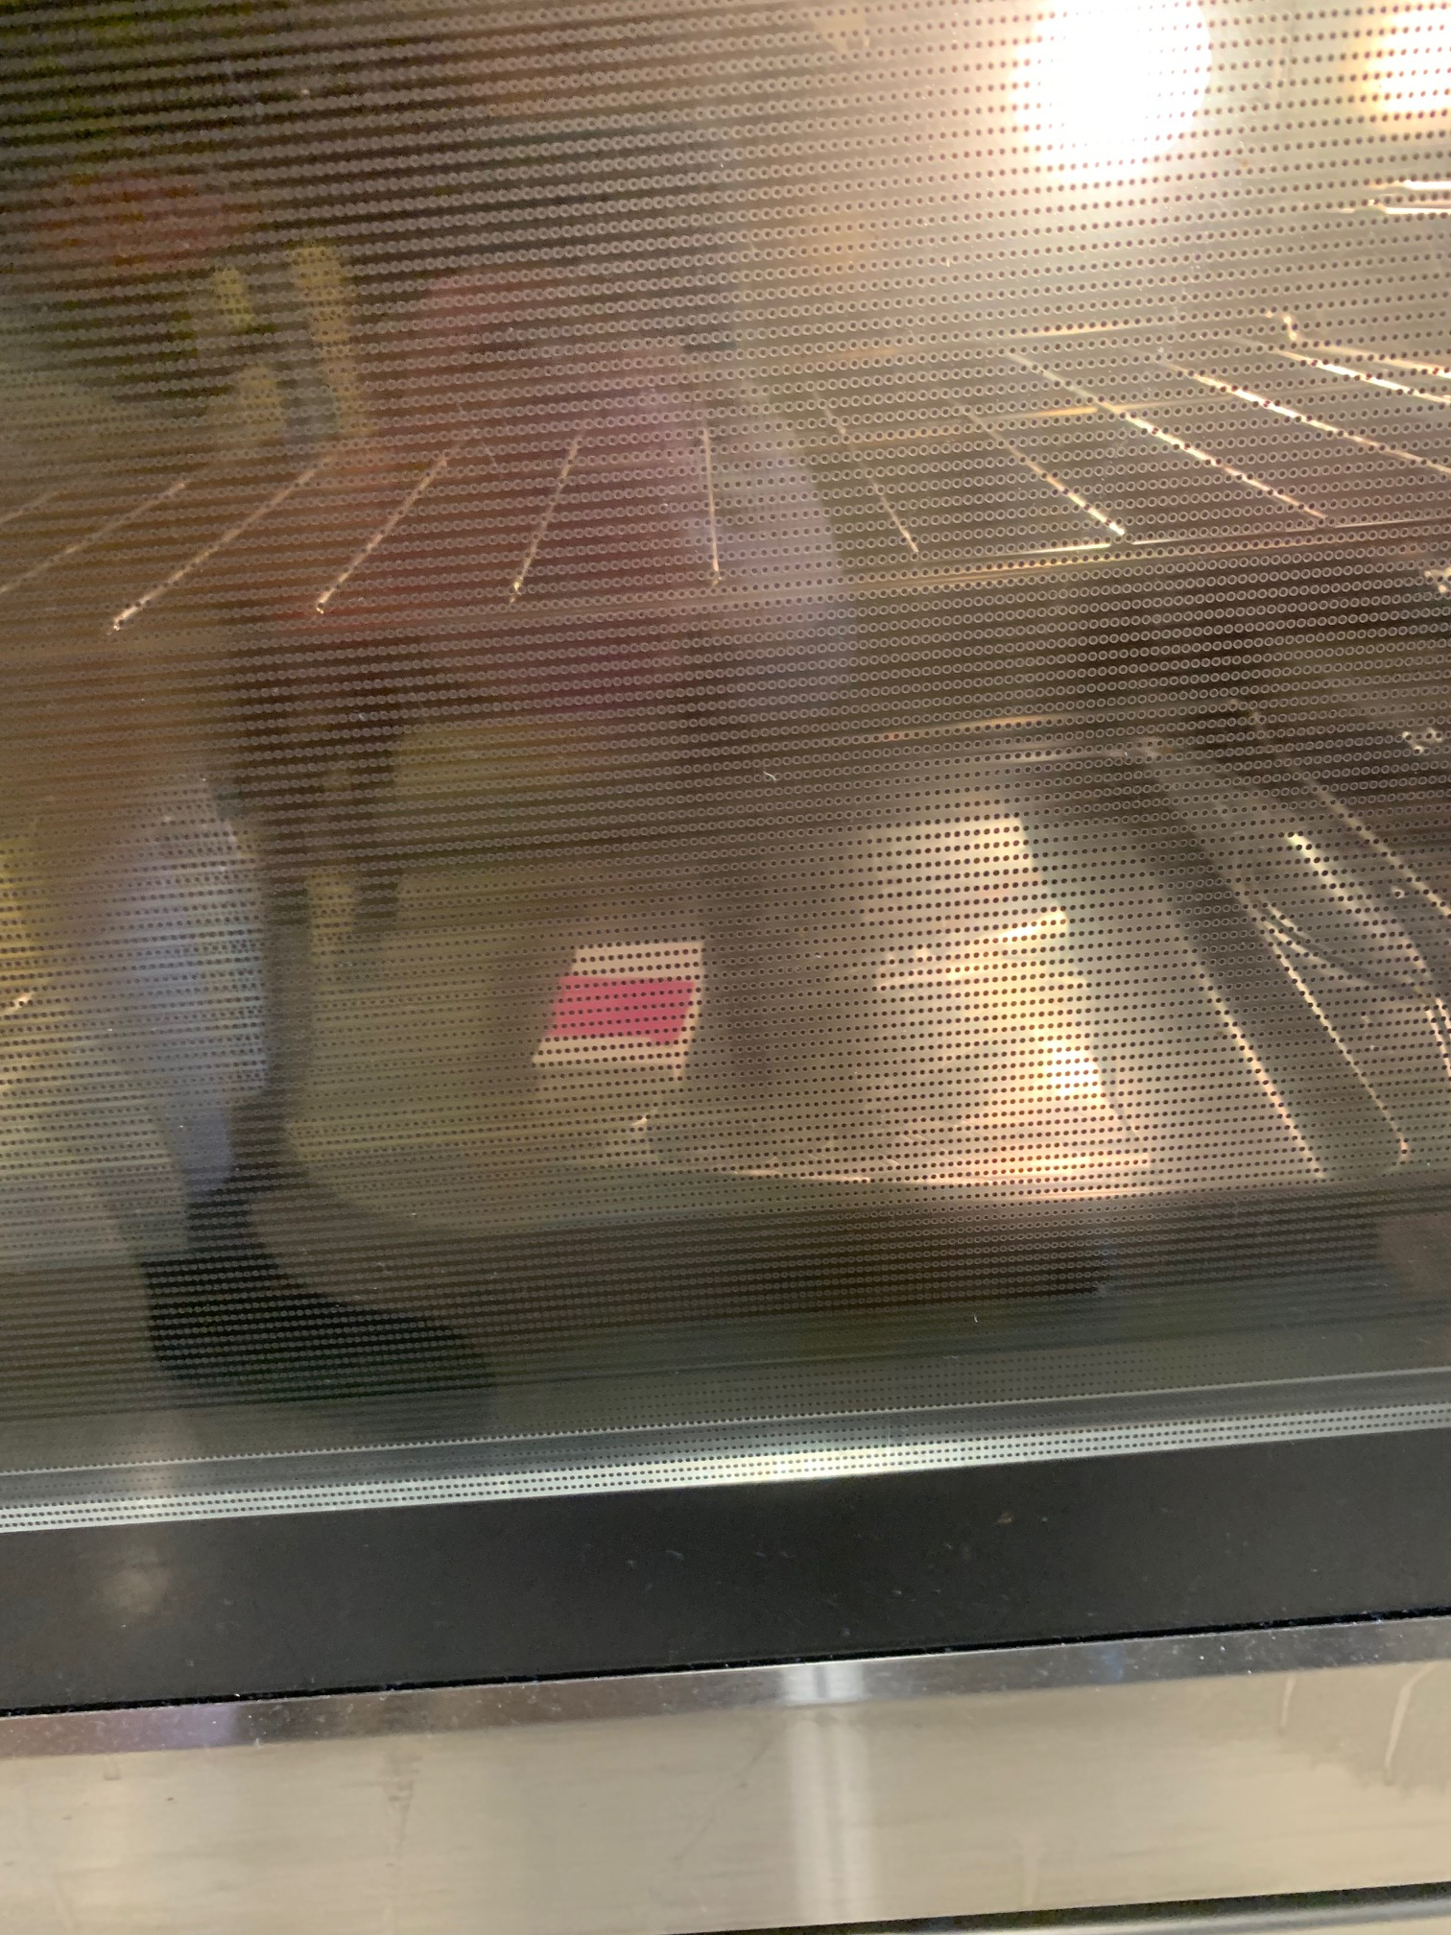
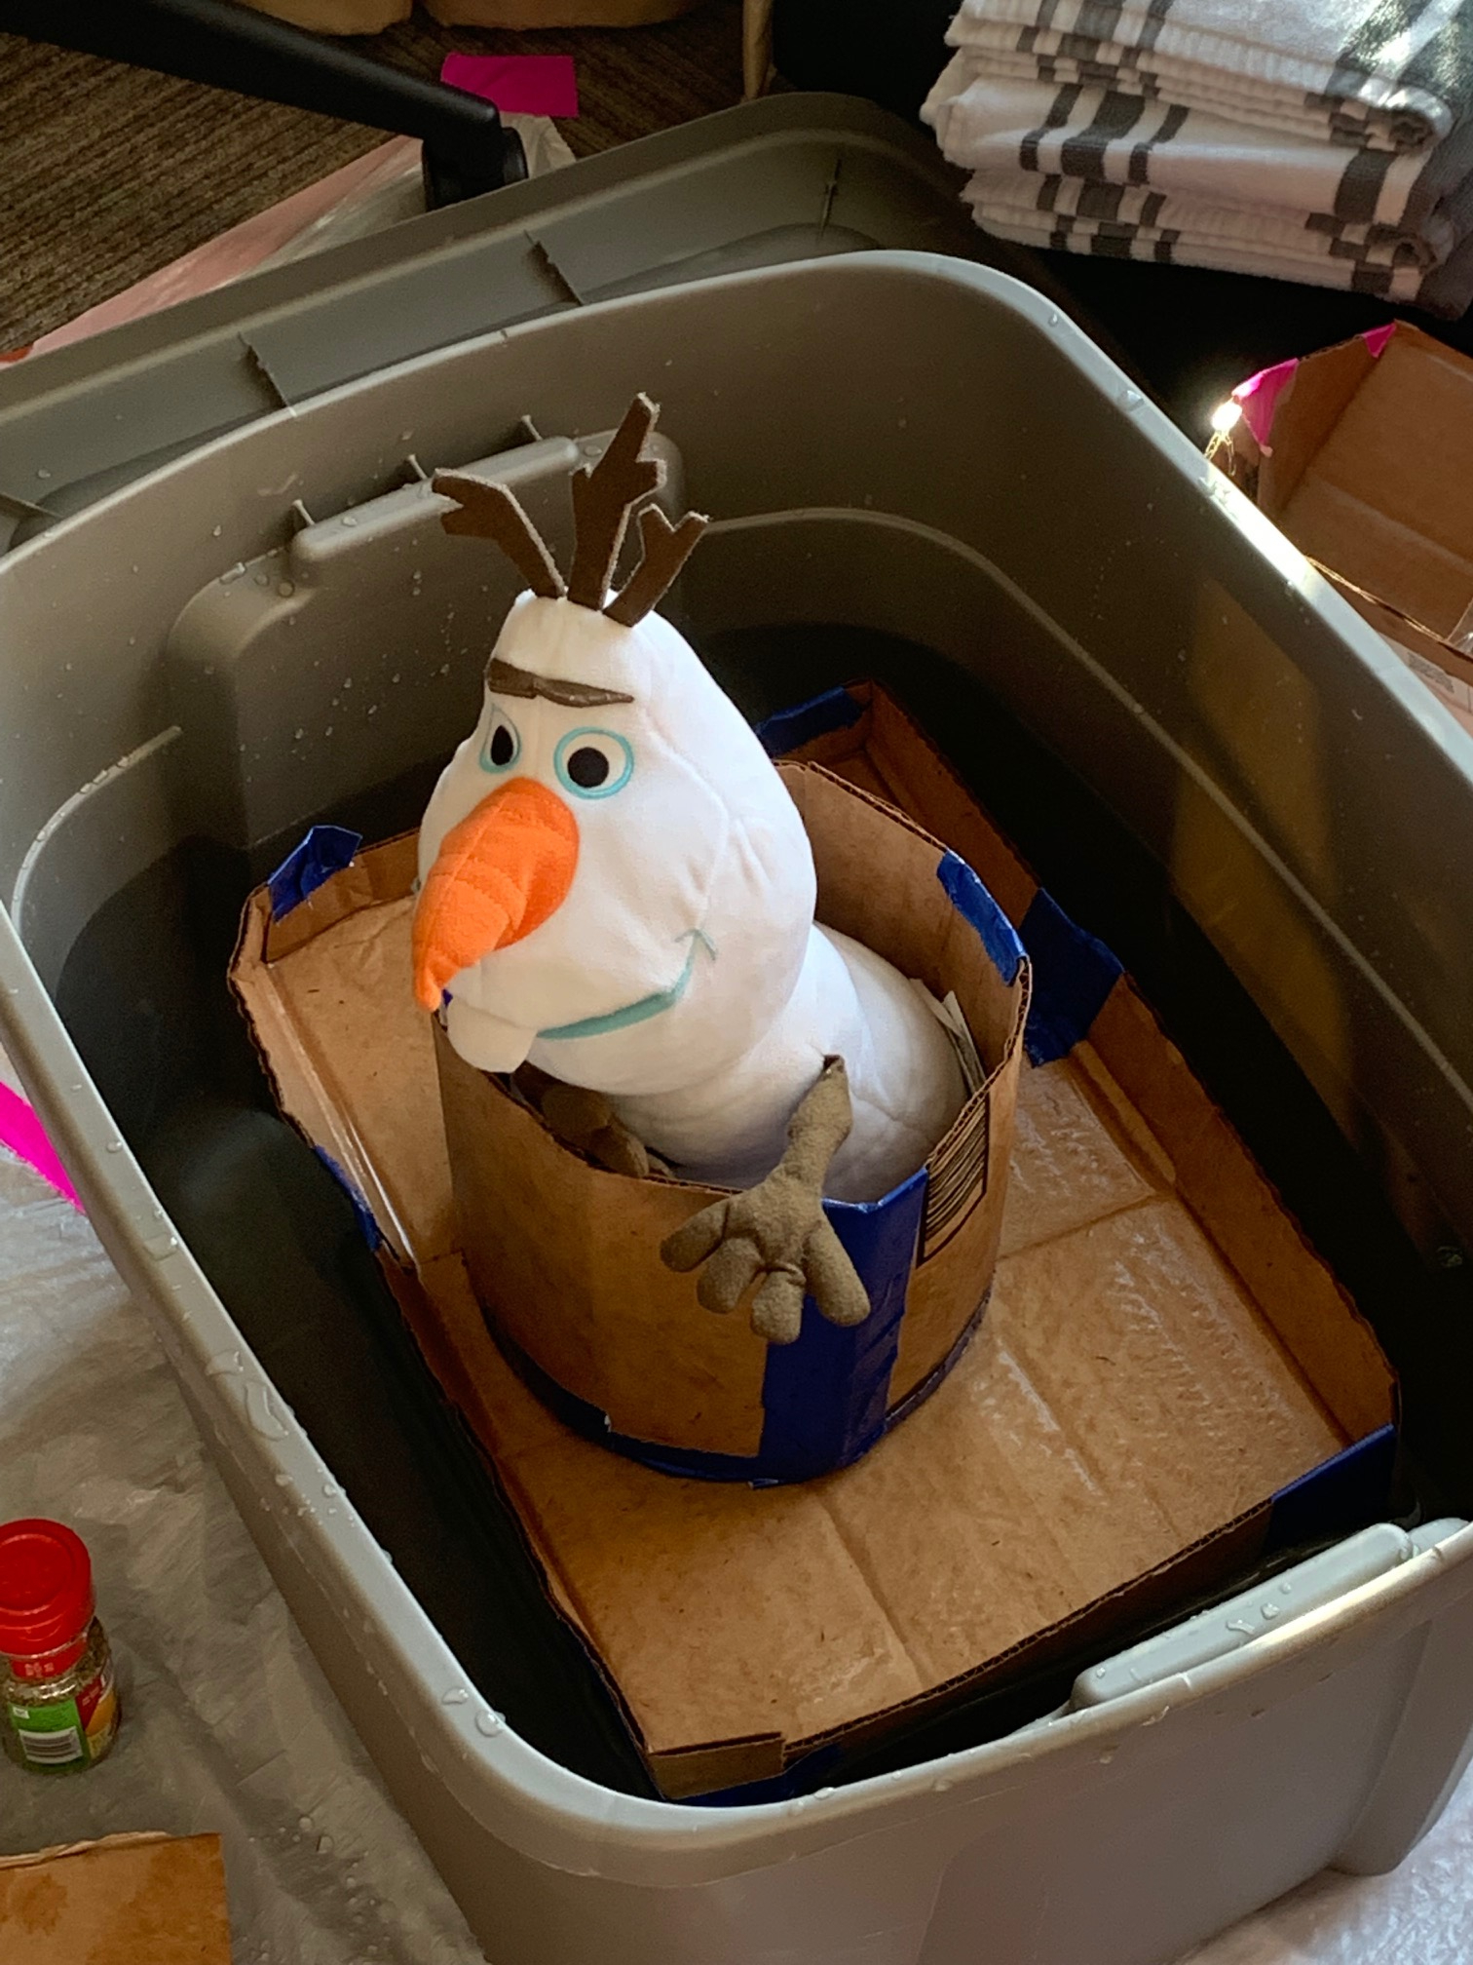
Testing Process
We tried baking the material to increase hardness.
We used abstract shaped objects, such as potatoes, to test the stability of the design.
We found out that the heat from the oven created a greater seal around the duck tape.

Slide 9
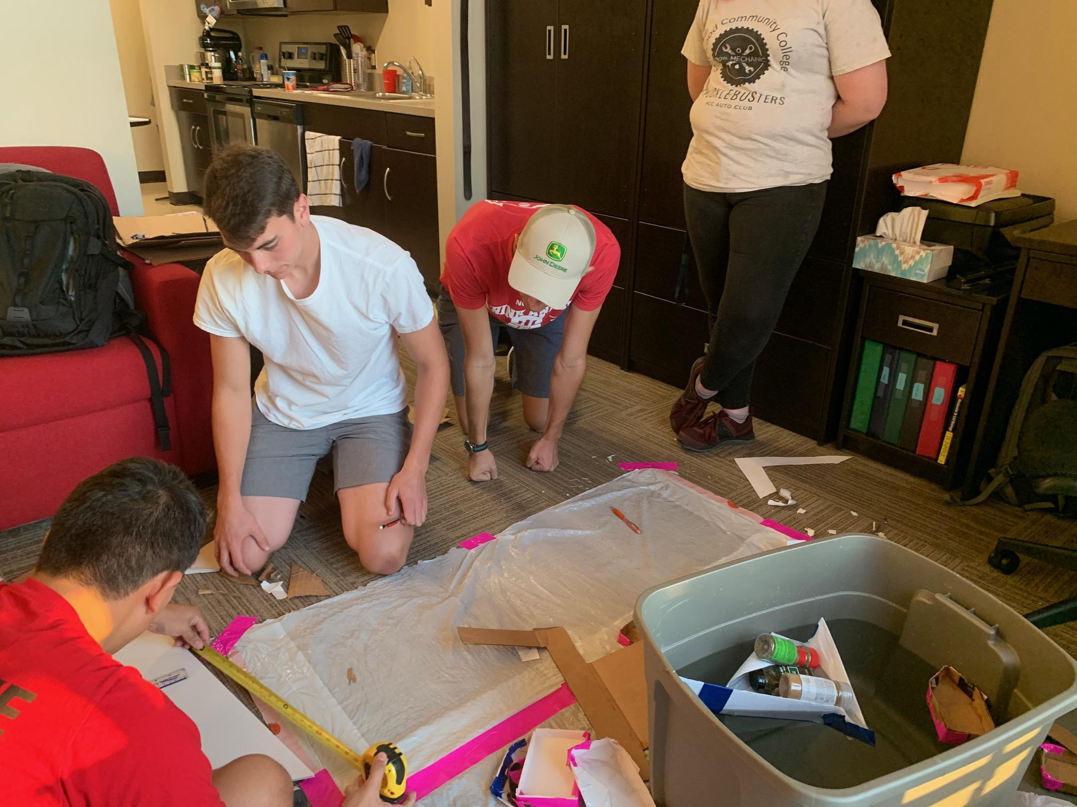
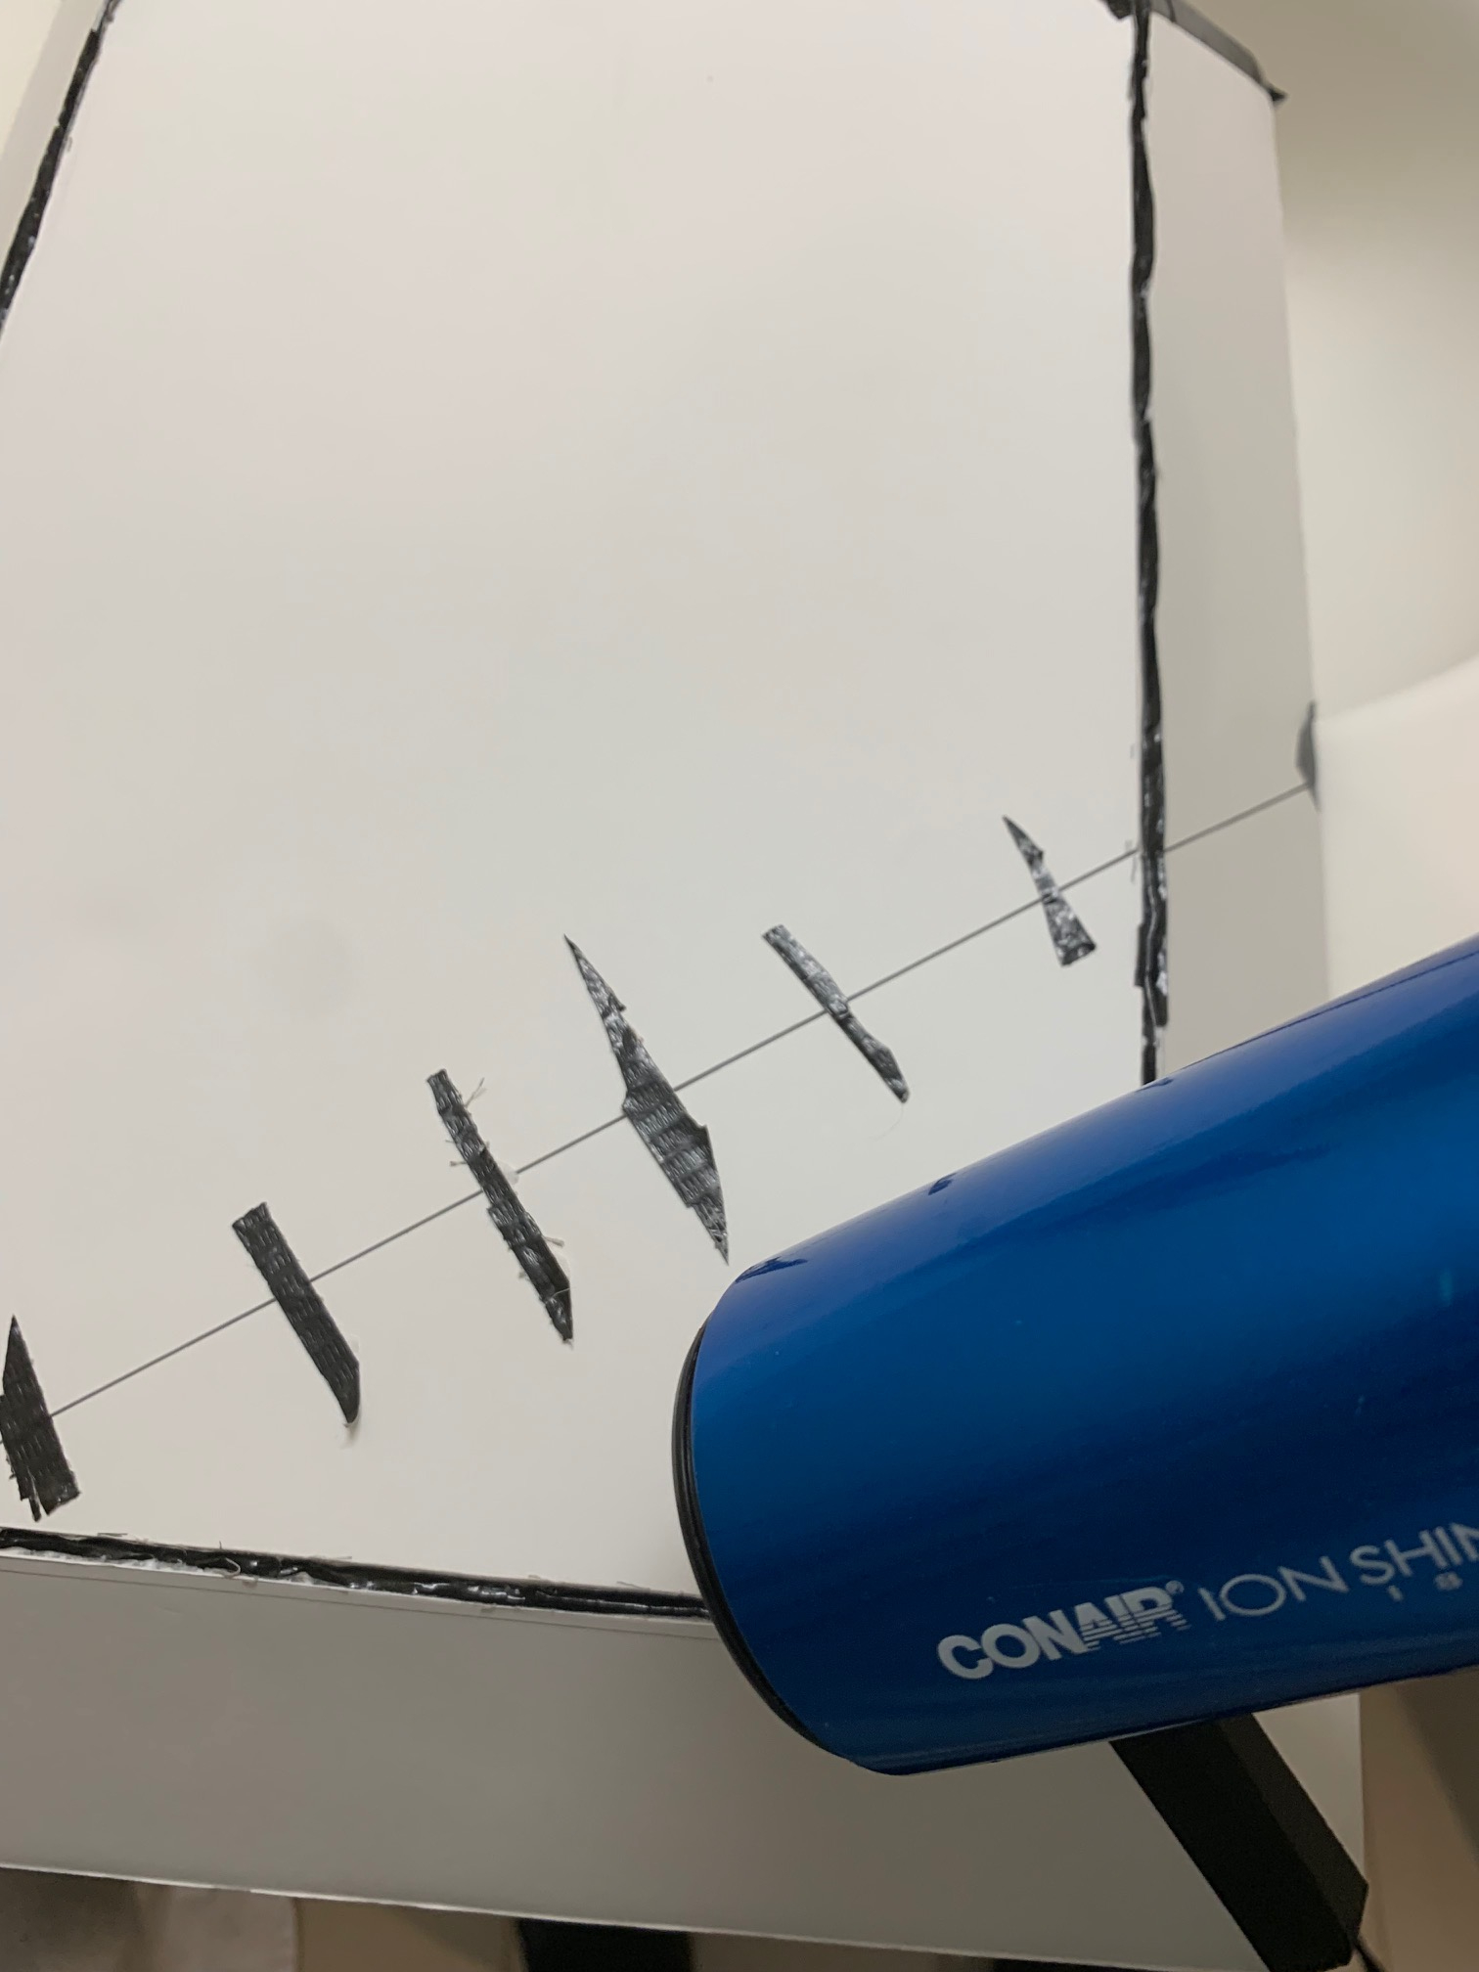
Final Design Fabrication
Through our testing, we discovered that a trapezoidal shape would provide the most volume displacement while remaining stable.
Felipe and Ethan were the best ‘cutters’ and ‘measures.’
Ralph and Devin were the best taping specialist.
Ashley was the best heat treatment specialist.

Slide 10
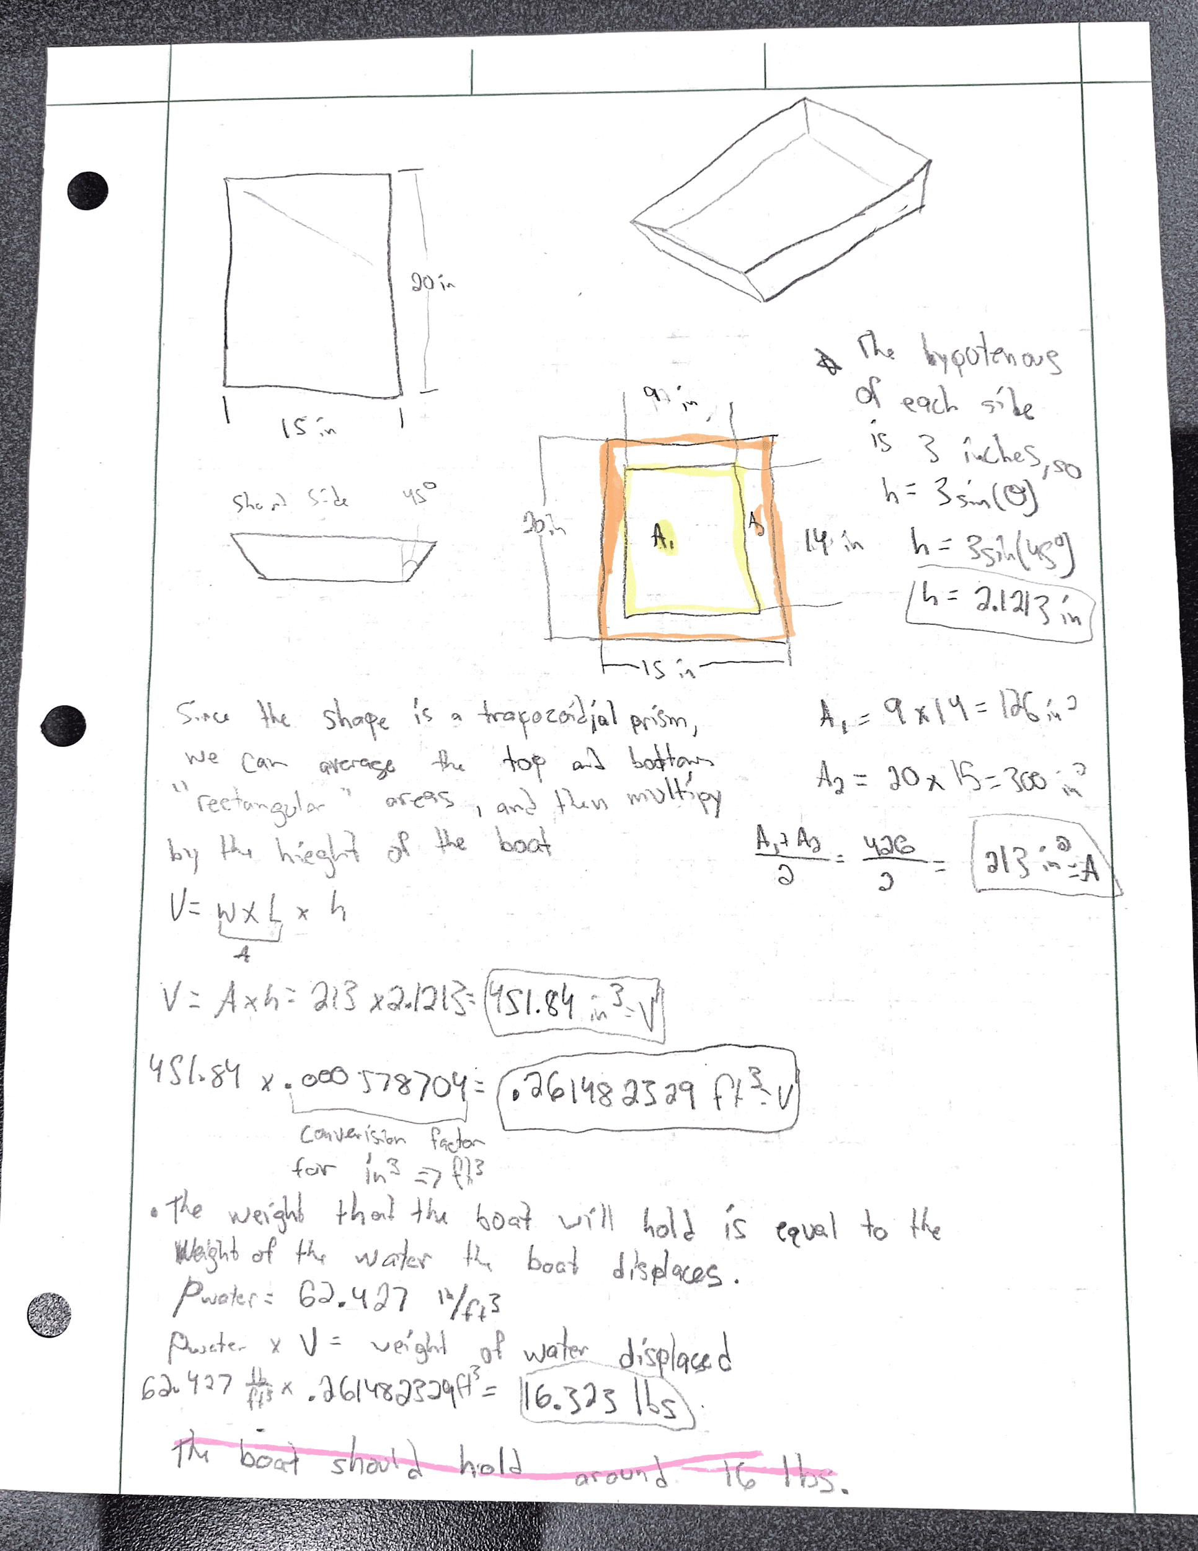
Calculation of Payload Weight
Our boat has a volume of approximately .2615 cubic feet.
The density of water is 62.427 lbs per cubic foot.
Weight displaced equals the weight the boat can hold.
Our boat can hold approximately 16 pounds.

Slide 11
Questions?

